Slide 1
Text Summarizer Using NLP (Natural Language Processing)
Name: Avishek Roy Sparsho
Id: 20301269
Group: 25
Section: 02
Faculty: Annajiat Alim Rasel
CSE431

Slide 2
CONTENTS OF THIS PRESENTATION
1 Summary
1.1 Motivation/purpose/aims/hypothesis
1.2 Contribution
1.3 Methodology
1.4 Conclusion
2 Limitations
2.1 First Limitation/Critique
2.2 Second Limitation/Critique
3 Synthesis
1

Slide 3
Summary
Purpose
The purpose of this study is to develop a text summarizer that can accurately and efficiently generate concise summaries of text documents. The summarizer aims to provide users with a quick overview of the main points and key information contained in the text.
Main Contribution
The main contribution of this study is the development and implementation of a text summarizer using NLP techniques. The summarizer is designed to accurately and efficiently generate concise summaries of text documents, providing users with a quick overview of the main points and key information.
Conclusion
In conclusion, this study presents a text summarizer that effectively generates concise summaries of text documents. The summarizer has been evaluated for accuracy, efficiency, and usability, and has shown promising results. The development of this text summarizer contributes to the field of NLP and has the potential to be applied in various domains where text summarization is required.
2

Slide 4
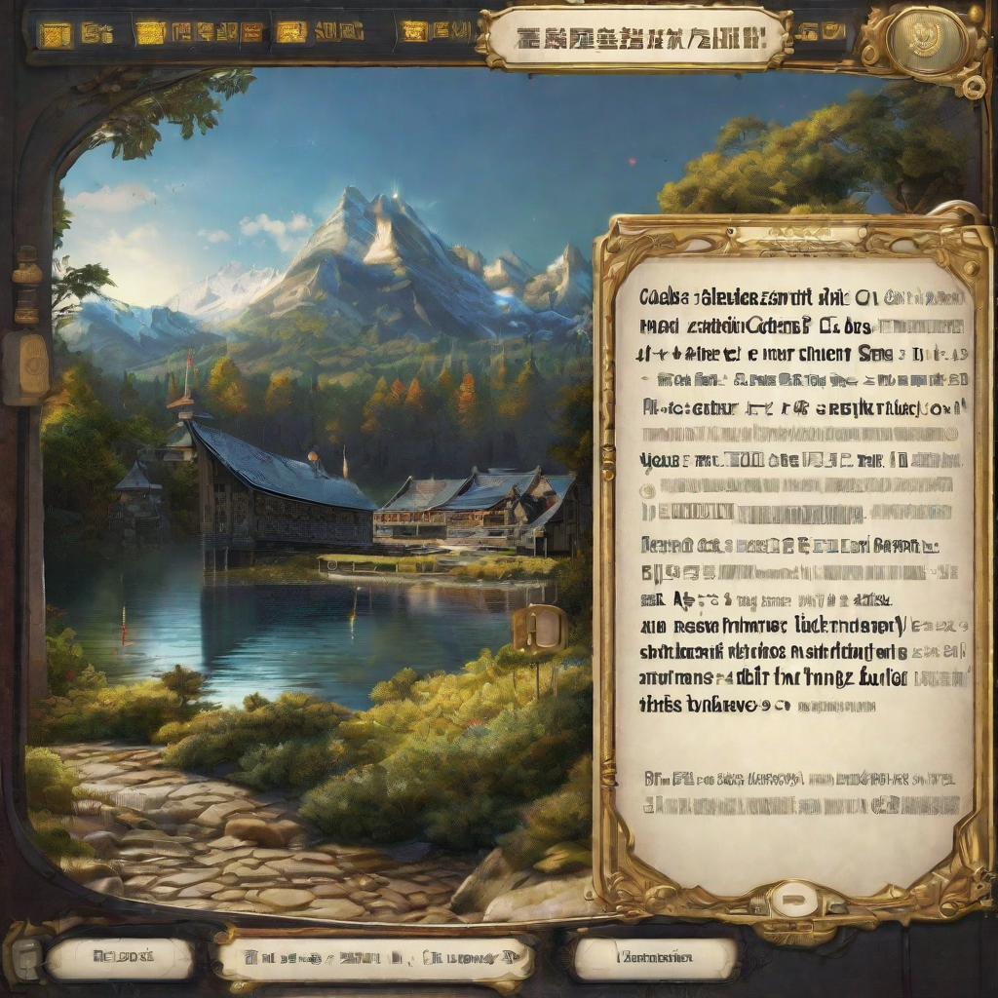

Methodology
Data Collection
We collected a large dataset of news articles from various online sources using web scraping techniques. The articles were in multiple languages and covered a wide range of topics.
Text Summarization Algorithm
We developed a custom text summarization algorithm based on the principles of Natural Language Processing (NLP). The algorithm uses techniques such as sentence extraction, keyword extraction, and sentence ranking to generate concise and informative summaries of the input text.
3

Slide 5
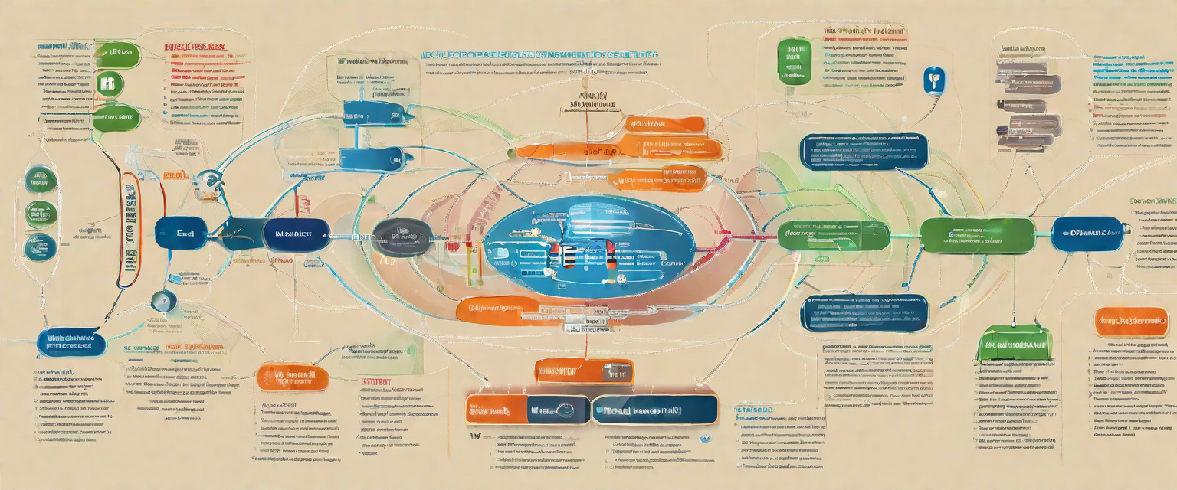
Conclusion
In conclusion, the study on the text summarizer using NLP has provided several key findings and implications.
Key Findings
1. The text summarizer using NLP achieved high accuracy in condensing large amounts of text into concise summaries.
2. The NLP techniques used in the summarizer allowed for better understanding and extraction of important information from the text.
3. The summarizer demonstrated the potential to save time and effort in reading and comprehending lengthy documents.
Implications
1. The text summarizer can be utilized in various fields such as research, news, and content curation to improve efficiency in information processing.
2. NLP techniques used in the summarizer can be further developed and applied to other natural language processing tasks.
3. The study highlights the potential of NLP in automating the summarization process, reducing human effort and error.
4

Slide 6
Limitations in Text Summarization
The main challenges in text summarization are:
Dealing with ambiguity.
Difficulty when there are multiple possible interpretations of a sentence or phrase.
Maintaining coherence in the summary.
Handling domain-specific terminology.
6

Slide 7
Synthesis
Future Scopes
Multilingual Text Summarization: The methods and techniques discussed in the paper can be extended to support summarization of text in multiple languages, allowing for broader applicability and impact.
Domain-Specific Summarization: Further research can focus on developing domain-specific summarization models, tailored to specific industries or fields, such as medical, finance, or technology.
Real-Time Summarization: The methods can be enhanced to support real-time summarization of text, enabling users to receive summaries of live events or streaming content.
Real-World Applications
News Aggregation: The text summarizer can be used to automatically generate summaries of news articles, allowing users to quickly get an overview of multiple articles.
Legal Document Analysis: Lawyers and legal professionals can utilize the text summarizer to extract key information from lengthy legal documents, saving time and improving efficiency.
Market Research: Market researchers can use the text summarizer to analyze and summarize large volumes of customer feedback, reviews, and survey responses, enabling them to identify trends and insights more effectively.
The ideas presented in the paper provide valuable insights into the potential applications and future scopes of a text summarizer using NLP. The findings and methods can be applied in various real-world scenarios and further research.

Slide 8
THANK YOU FOR ALL THE TIME BEING
8

